Slide 1

Code Port Website
Group No: - | 30
College Name:- | L.J. INSTITUTE OF COMPUTER APPLICATIONS
Project Title:- | Code Port Website
Course Name: | Integrated Master Of Computer Application (IMCA)
Semester: - | 8
Guided By: - | Prof. Jayshree Dasa
Group Members:
1 | Kshama Gandhi | 205180686059
2 | Purvi Makwana | 205190686059

Slide 2

Introduction
It is a website named "CODE PORT". The main purpose of this portal is for User to Ask and answer question. We have developed this website in PHP as Front End with the MYSQL as a back end and various CSS as well as to fulfil our website's “CODE PORT”. This project provides Share knowledge and solve coding challenges. When you log in it, we can access the process of different question. This website saves your times and power. It is very easy to handle and it is very simple. The project entitled “Code Port” enables a user to provide a facility of solving their doubts through online.

Slide 3
Existing System
Creating a Cort Port in Laravel, a web development framework, involves setting up your project, designing your database, and writing code to make everything work. Laravel makes it easy to manage users, like signing up and logging in, thanks to its built-in tools. You'll create pages where users can ask questions, answer them, and vote on the best answers. Laravel helps organize your code so that everything stays neat and easy to understand. It also helps you search for questions and answers quickly. When users type in keywords, Laravel finds the relevant stuff fast. For how it looks, you'll use Blade, which is like a fancy way to write HTML. Blade makes it simple to create web pages that look good and work well. Of course, you'll also need to make sure your website is safe from hackers. Laravel has built-in tools to help with that too, so you can feel confident your users' information is secure.

Slide 4

Need For the New System
The old manual system was suffering from a series of drawbacks. Since whole of the system was to be maintained with hands the process of keeping, maintaining and retrieving the information was tedious and lengthy. The records were never used to be in a systematic order. There used to be lots of difficulties in associating any particular transaction with a particular context. If any information was to be found it was required to go through the different registers, documents there would never exist anything like report generation. There would always be unnecessary consumption of time while entering records and retrieving records. It was very difficult to find errors while entering the records. Once the records were entered it was very difficult to update records. To overcome such reasons, a computerized system is created.

Slide 5

Objective Of the New System
User Engagement
User Management
Content Organization
Security
Scalability and Performance
Community Building

Slide 6

Problem Definiation
In the current websites might have information spread out or not very engaging features. So, we want to create a platform where it's easy to find answers and where users can interact with each other in a friendly way. With our Stack Overflow clone, we aim to bring all the helpful info together, make searching for it simple, and encourage users to help each other out. Plus, we'll make sure it's safe to use and can handle lots of people using it at once. Our goal is to make a website where anyone can get the help they need and feel like part of a supportive community.

Slide 7

Core Components
User Management
Question and Answer System
Tagging and Categorization
Search Functionality
Voting and Reputation System
Notification System
Moderation tools

Slide 8

Project Profile
Project Title: - | Code Port
Front-end Tool: - | PHP Laravel, HTML, CSS.
Back-end Tool: - | SQL Server
Duration: - | 4 months
Team - Size: - | 3
Guided by: - | Prof. Jayshree Dasa
Developed by: - | Kshama Gandhi | 205180686059
 | Purvi Makwana |205190686059

Slide 9


Assumption and Constarints
The code should be free with compilation errors/syntax errors.
The product must have an interface which is simple enough to understand.

Slide 10

Advantages and Limitations of the Proposed System
Advantages:
The Code Port will be able to post his ads on the website.
The customer will be able to access that post and contact the renter.
The renter and customer documentation/dealing/payment will be done face to face to avoid spam.
This system is fully functional and flexible.
It saves a lot of time, money and labour.
First the customer has to do registration.
Second if the customer had already registered himself/herself then he/she can continue booking in his/her own account by giving his/her customer id or mail id.
Thirdly, the customer can amend details or update details.
Maintenance is easy and performance is good.
It reduces the time complexity.

Slide 11

Advantages and Limitations of the Proposed System
Disadvantages:
Inconvenience for customer
Manual record-keeping
Lack of transparency
Security risks
Time-Consuming
High administrative burden

Slide 12

Requirement Determination
Hardware Requirements
Pentium IV 2.0 GHz or higher processor.
1 GB or higher capacity RAM.
60 GB or higher capacity Hard Disk
Color monitor
Software Requirements
Operating system: Windows 10
Microsoft Visual Studio code / notepad
Software: Xampp (8.1.6)

Slide 13

Requirement Specification
Functional Requirements: Admin User Service Providing | Non-Functional Requirements Reliable Security Interface

Slide 14

Targeted User
Admin
User

Slide 15
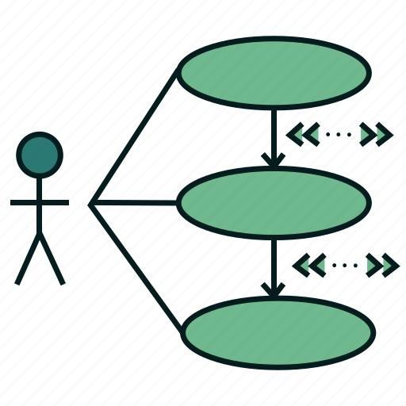
Use Case Diagram

Slide 16
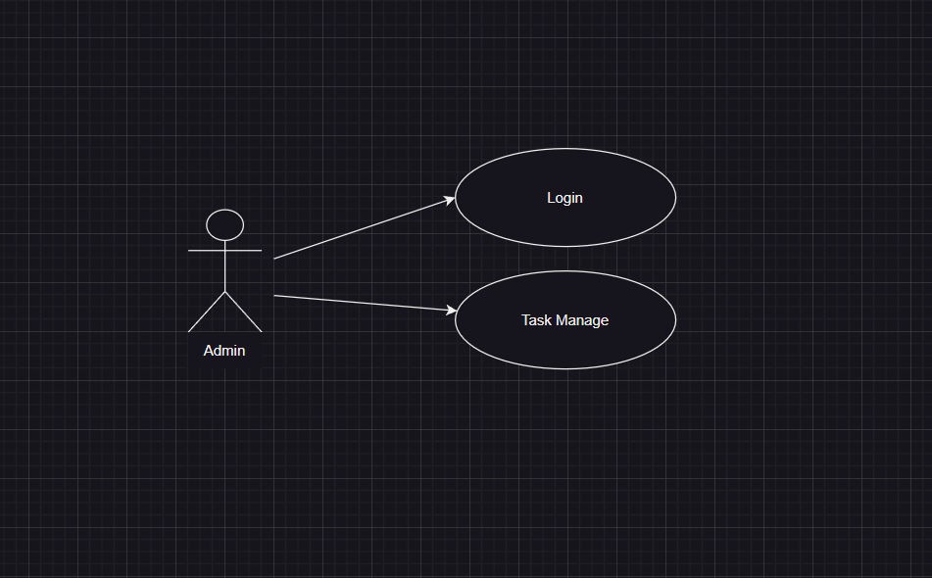
Admin

Slide 17
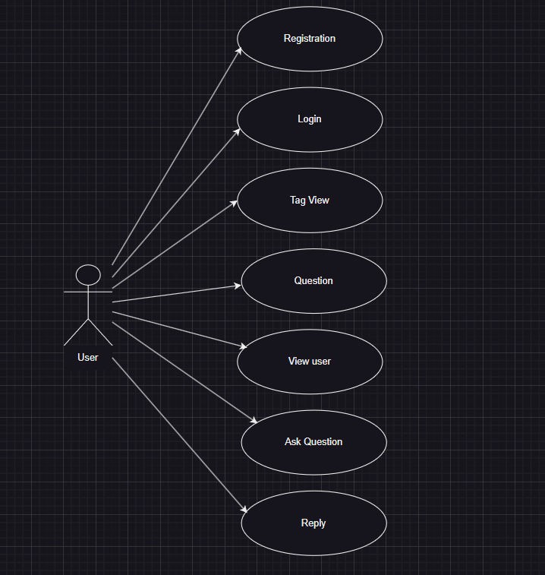
User

Slide 18
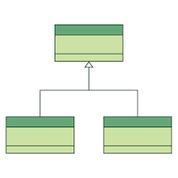
Class Diagram

Slide 19
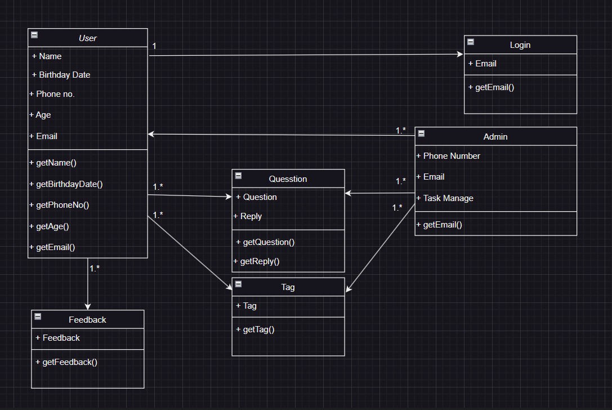

Slide 20
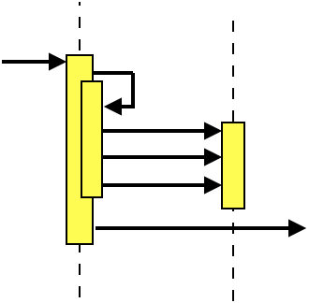
Interaction Diagram

Slide 21
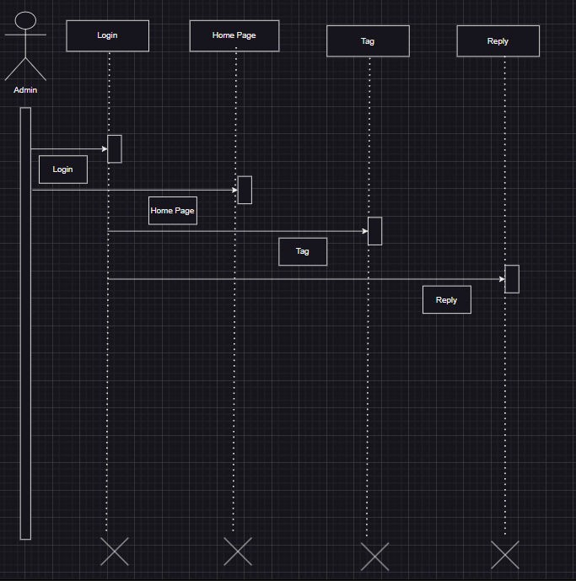
Admin

Slide 22
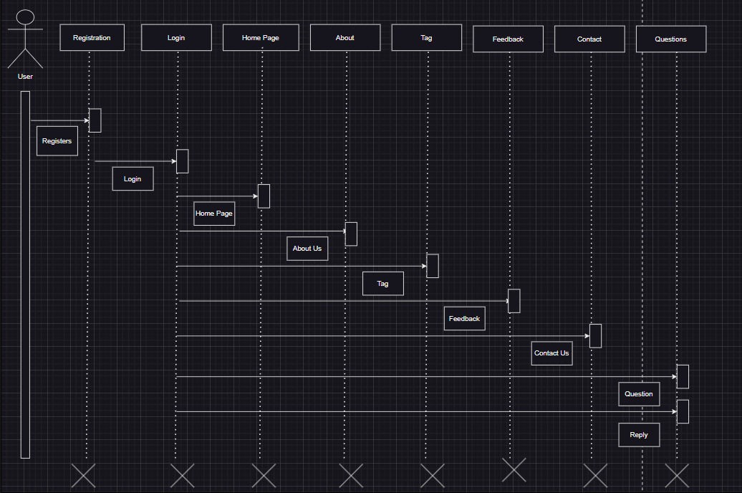
User

Slide 23
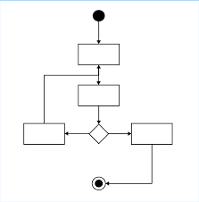
Activity Diagram

Slide 24
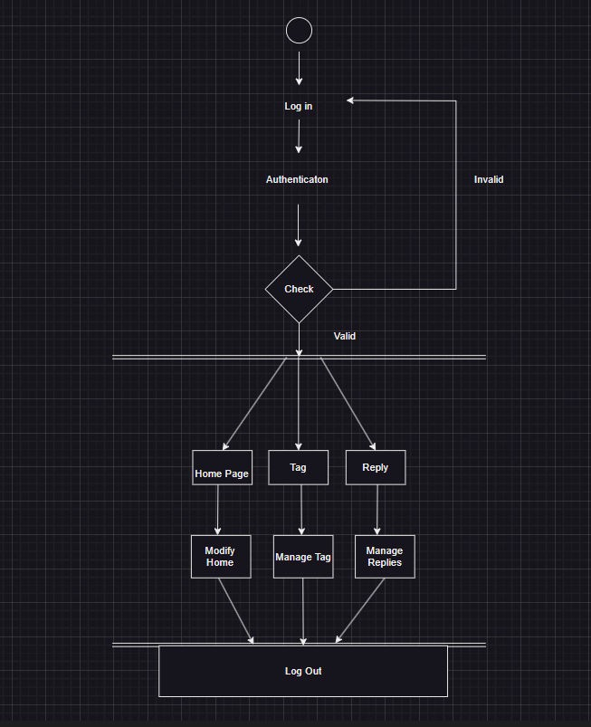
Admin

Slide 25
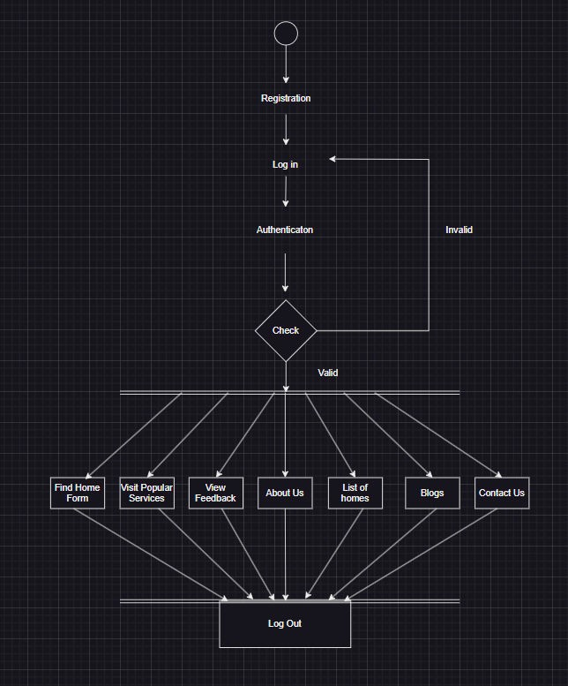
User

Slide 26
Data Dictionary
Admin Table
Column Name | Data Type | Constraint | Descrpition
A_ID | Int | PrimaryKey | Enter user id
A_name | Varchar(50) | Not Null | Enter User name
Email | Varchar(50) | Not Null | Enter email id
Password | Varchar(50) | Not Null | Enter Password

Slide 27
Data Dictionary
Users Table
Column Name | Data Type | Constraint | Descrpition
U_id | Int | PrimaryKey | Enter My JobID
U_name | Varchar(50) | Not Null | Enter user name
U_email | Varchar(50) | Not Null | Enter Email id
B_date | Datetime | Not Null | Enter Birth date
U_age | Int | Not Null | Enter Age
P_no | Int | Not Null | Enter phone number
Password | Varchar | Not Null | Enter password

Slide 28
Data Dictionary
Tags Table
Column Name | Data Type | Constraint | Descrpition
T_id | Int | PrimaryKey | Enter Tag ID
T_title | Varchar(50) | Not Null | Enter title of language
T_des | Varchar(255) | Not Null | Enter tag description
T_icon | - | Not Null | Insert logo of language

Slide 29
Data Dictionary
Questions Table
Column Name | Data Type | Constraint | Descrpition
Q_id | Int | PrimaryKey | Enter Question ID
User_id | Int | Not Null | Enter User ID
Q_title | Varchar(50) | Not Null | Enter Question title
Q_body | Varchar(255) | Not Null | Enter full Questions
T_id | Varchar(50) | Not Null | Select tag

Slide 30
Data Dictionary
Replies Table
Column Name | Data Type | Constraint | Descrpition
R_id | Int | Not Null | Enter Reply id
R_date | Date | Not Null | Enter Reply date
Q_id | Int | Not Null | Select Question id
Reply | Varchar(255) | Not Null | Enter reply
U_id | Int | Not Null | Select user id

Slide 31
Data Dictionary
Feedback Table
Column Name | Data Type | Constraint | Descrpition
F_id | Int | Not Null | Enter feedback id
F_name | Varchar(50) | Not Null | Enter feedback user name
F_email | Varchar(50) | Not Null | Enter email id
Message | Varchar(255) | Not Null | Enter message
F_date | Date | Not Null | Enter date

Slide 32
Coding Standards
Coding Style
The following should be kept in mind to maintain a coding style. Such are, Layout, Format, Indentation, organizing code meaningfully, code must be readable and consistent which makes it easy to understand and maintain further.
Formatting
Always use comments for description.
Always use curly braces {and} in conditional statements.
Example:
if (condition)
{ // comment }
Order declarations within type groups based upon access modifier and their accessibility.
Public Protected Internal Private Commenting
All comments should be written in U.S. English. Use # or “””…””” but do NOT use /* *

Slide 33
Agile
Agile Project Charter:
General Project Information
Project Name | Code Port
Project Champion | Kshama Gandhi Purvi Makwana
Project Sponsor | LJ Institute of Computer Applications
Project Manager | Jayshree Dasa
Project Stackholder | Admin User
Expected Start Date | 10/01/2024
Expected Completion Date | 05/04/2024

Slide 34
Project Details
Mission | Our mission is to create a vibrant and supportive online community where developers, programmers, and technology enthusiasts can collaborate, share knowledge, and learn from each other's experiences.
Vision | Our vision is to revolutionize the way developers and technology enthusiasts collaborate, learn, and grow together.
Date | 10th April 2024

Slide 35
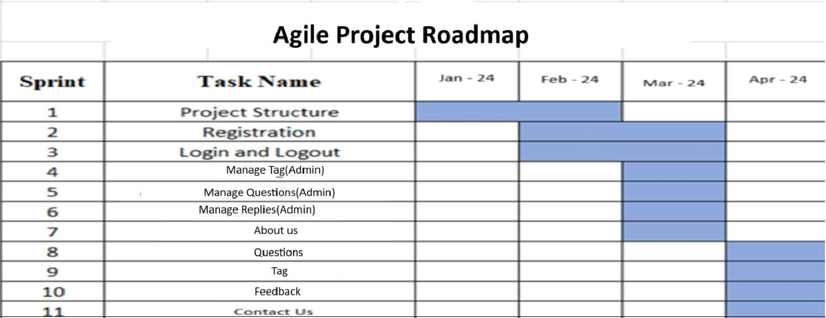
Agile roadmap/schedule:

Slide 36
Agile Project Plan:
Task Name | Duration | Start | Finish | Status
Sprint#1 : Project Structure | 7d | 10/01/2024 | 17/01/2024 | Completed
UI Designing | 4d | 17/01/2024 | 21/01/2024 | Completed
Database Management | 3d | 21/01/2024 | 24/01/2024 | Completed
Sprint#2 : Registration | 5d | 24/01/2024 | 29/01/2024 | Completed
User Registration | 5d | 29/01/2024 | 03/02/2024 | Completed
Sprint#3 : Login and Logout | 4d | 03/02/2024 | 07/02/2024 | Completed
User Login | 2d | 07/02/2024 | 09/02/2024 | Completed
Admin Login | 3d | 09/02/2024 | 12/02/2024 | Completed
Sprint#4 : Manage Tag(Admin) | 2d | 12/02/2024 | 14/02/2024 | Completed
Admin manages tag | 2d | 14/02/2024 | 16/02/2024 | Completed
Sprint#5 : Manage Questions(Admin) | 9d | 16/02/2024 | 25/02/2024 | Completed
Admin manages questions | 9d | 25/02/2024 | 05/03/2024 | Completed
Sprint#6 : Manage Replies(Admin) | 5d | 05/03/2024 | 10/03/2024 | Completed
Admin manages replies | 2d | 10/03/2024 | 12/03/2024 | Completed
Sprint#7 : About Us | 6d | 10/03/2024 | 16/03/2024 | Completed

Slide 37
Agile Project Plan:
View About Us Page | 2d | 16/03/2024 | 18/03/2024 | Completed
Sprint#8 : Questions | 1d | 18/03/2024 | 19/03/2024 | Completed
View and ask questions | 1d | 19/03/2024 | 20/03/2024 | Completed
Sprint#9 : Tag | 1d | 20/03/2024 | 21/03/2024 | Completed
View and select tag for the question | 1d | 21/03/2024 | 22/03/2024 | Completed
Sprint#10 : Feedback | 1d | 22/03/2024 | 23/03/2024 | Completed
Give Feedback | 1d | 23/03/2024 | 24/03/2024 | Completed
Sprint#11 : Contact Us | 4d | 24/03/2024 | 28/03/2024 | Completed
Contact us | 1d | 28/03/2024 | 29/03/2024 | Completed

Slide 38
Agile User Story:
User Story ID | As a (type of user) | I want to (perform some task) | So that I can (achieve some goal)
1 | Admin | Manage Login Module | Ensure that validate user can join
2 | Admin | View User | View User
3 | Admin | Manage password | Ensures the password is valid
4 | User | About Us | Redirect to About Us page
5 | User | Questions | Ask questions
6 | User | Feedback | Give Feedback
7 | User | Tag | Select tag for the questions
8 | User | Contact Us | Redirect to Contact page
9 | Admin | Manage Tag | Manage tag
10 | Admin | Manage Questions and replies | Manage questions and replies

Slide 39
Agile Release Plan:
Task Name | Durati on | Start | Finish | Status
Sprint#1 : Project Structure | 7d | 10/01/2024 | 17/01/2024 | Completed
UI Designing | 4d | 17/01/2024 | 21/01/2024 | Completed
Database Management | 3d | 21/01/2024 | 24/01/2024 | Completed
Sprint#2 : Registration | 5d | 24/01/2024 | 29/01/2024 | Completed
User Registration | 5d | 29/01/2024 | 03/02/2024 | Completed
Sprint#3 : Login and Logout | 4d | 03/02/2024 | 07/02/2024 | Completed
User Login | 2d | 07/02/2024 | 09/02/2024 | Completed
Admin Login | 3d | 09/02/2024 | 12/02/2024 | Completed
Sprint#4 : Manage Tag(Admin) | 2d | 12/02/2024 | 14/02/2024 | Completed
Admin manages tag | 2d | 14/02/2024 | 16/02/2024 | Completed
Sprint#5 : Manage Questions(Admin) | 9d | 16/02/2024 | 25/02/2024 | Completed
Admin manages questions | 9d | 25/02/2024 | 05/03/2024 | Completed
Sprint#6 : Manage Replies(Admin) | 5d | 05/03/2024 | 10/03/2024 | Completed
Admin manages replies | 2d | 10/03/2024 | 12/03/2024 | Completed
Sprint#7 : About Us | 6d | 10/03/2024 | 16/03/2024 | Completed
View About Us Page | 2d | 16/03/2024 | 18/03/2024 | Completed
Sprint#8 : Questions | 1d | 18/03/2024 | 19/03/2024 | Completed
View and ask questions | 1d | 19/03/2024 | 20/03/2024 | Completed
Sprint#9 : Tag | 1d | 20/03/2024 | 21/03/2024 | Completed
View and select tag for the question | 1d | 21/03/2024 | 22/03/2024 | Completed
Sprint#10 : Feedback | 1d | 22/03/2024 | 23/03/2024 | Completed
Give Feedback | 1d | 23/03/2024 | 24/03/2024 | Completed
Sprint#11 : Contact Us | 4d | 24/03/2024 | 28/03/2024 | Completed
Contact us | 1d | 28/03/2024 | 29/03/2024 | Completed

Slide 40
Agile Sprint Backlog:
Task Name | Durat ion | Start | Finish | Status
Sprint#1 : Project Structure | 7d | 10/01/2024 | 17/01/2024 | Completed
UI Designing | 4d | 17/01/2024 | 21/01/2024 | Completed
Database Management | 3d | 21/01/2024 | 24/01/2024 | Completed
Sprint#2 : Registration | 5d | 24/01/2024 | 29/01/2024 | Completed
User Registration | 5d | 29/01/2024 | 03/02/2024 | Completed
Sprint#3 : Login and Logout | 4d | 03/02/2024 | 07/02/2024 | Completed
User Login | 2d | 07/02/2024 | 09/02/2024 | Completed
Admin Login | 3d | 09/02/2024 | 12/02/2024 | Completed
Sprint#4 : Manage Tag(Admin) | 2d | 12/02/2024 | 14/02/2024 | Completed
Admin manages tag | 2d | 14/02/2024 | 16/02/2024 | Completed
Sprint#5 : Manage Questions(Admin) | 9d | 16/02/2024 | 25/02/2024 | Completed
Admin manages questions | 9d | 25/02/2024 | 05/03/2024 | Completed
Sprint#6 : Manage Replies(Admin) | 5d | 05/03/2024 | 10/03/2024 | Completed
Admin manages replies | 2d | 10/03/2024 | 12/03/2024 | Completed
Sprint#7 : About Us | 6d | 10/03/2024 | 16/03/2024 | Completed
View About Us Page | 2d | 16/03/2024 | 18/03/2024 | Completed
Sprint#8 : Questions | 1d | 18/03/2024 | 19/03/2024 | Completed
View and ask questions | 1d | 19/03/2024 | 20/03/2024 | Completed
Sprint#9 : Tag | 1d | 20/03/2024 | 21/03/2024 | Completed
View and select tag for the question | 1d | 21/03/2024 | 22/03/2024 | Completed
Sprint#10 : Feedback | 1d | 22/03/2024 | 23/03/2024 | Completed
Give Feedback | 1d | 23/03/2024 | 24/03/2024 | Completed
Sprint#11 : Contact Us | 4d | 24/03/2024 | 28/03/2024 | Completed
Contact us | 1d | 28/03/2024 | 29/03/2024 | Completed

Slide 41
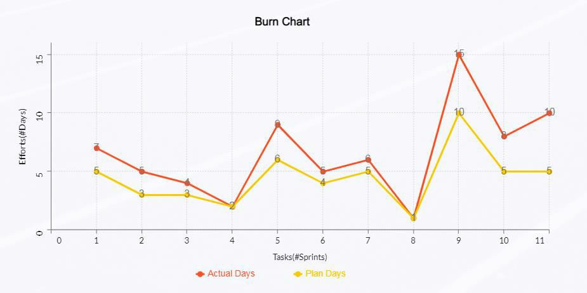

Slide 42
Agile Test Plan:
Test Case ID : 101 | Test Case Name : User Login
Designed by : Kshama Gandhi | Design Date :- 05/02/2024
Module Name : User Login | Sub Module Name : Login
Executed by : Kshama Gandhi | Execution Date : 05/02/2024
Brief Description : User Login (with Data : “email : t@g.com & password:1234”) | Test Priority (Low/Medium/High) : High
Pre-Conditions: User Must Registered have | Correct Username & Password.
Dependencies : None
Test Step | Test Data | Expected Result | Actual Result | Status (Pass/Fail) | Remarks
1 | Email: t@g.com Password: 1234 | Successfully login & redirect to Home Page. | Login Successful. | Pass | None
2 | Email: t1@g.com Password: 1234 | Show “Invalid Credentials.” | Login Not Succe ssful | Fail | Need to Show Error Message.
3 | Email: t@g.com Password: 1234Mah | Show “Invalid Credentials.” | Login Not Succe ssful | Fail | Need to Show Error Message.
4 | Email: t@g.com Password: 1234 | Successfully login in to system & redirect to home Page. | Login Successful & Redirect to home Page. | Pass | None

Slide 43
Agile Test Plan:
Test Case ID : 102 | Test Case Name : User Registration
Designed by : Purvi Makwana | Design Date : 30/03/2024
Module Name : User Registration | Sub Module Name : Register
Executed by : Purvi Makwana | Execution Date : 30/03/2024
Brief Description: User Registration page for the new user. User needs to provide the correct details for Registration. | Test Priority (Low/Medium/High) : High
Pre-conditions : None

Slide 44
Agile Test Plan:
 | Test Step | Test Data | Expected Result | Actual Result | Status (Pass/Fail) | Remarks
 | 1 | First Name: Purvi Last Name: Makwana Email: purvi@gmail.c om Password: 1234 Confirm Password: 1234 | Successf ully Registere d & Redirect to Login Page. | Registe red Success fully. | Pass | redirect to login Page.
 | 2 | First Name: Purvi Last Name: Makwana Email: purvi@gmail.c om Password: 1234 Confirm Password: 12345 | Show Error Mess age as “Pass word & Confi rm Passwo rd must be Equal” | Not Registere d & remain in Registrati on page. | Fail | None
 | 3 | First Name: Purvi Last Name: Makwana Email: purvi@gmail.c om Password: 1234 Confirm Password: 1234 | Show Error Message as “Email Id Alr ea dy Exi st” | Not Registere d & remain in Registrati on page. | Fail | None
 | 4 | First Name: Purvi Last Name: Makwana Email: purvi@gmail.c om Password: 4321 Confirm Password: 4321 | Succ essful ly Regis tered & | Success fully Register ed & | Pass | None
Dependencies: Username & Password are store & fetch from auth_user Table.

Slide 45
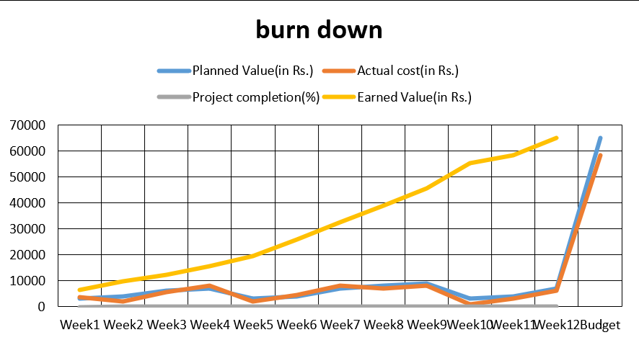
Earned-value and burn charts:

Slide 46
Proposed Enhancements:
To enhance Code Port Website built in Laravel, several features and improvements can be proposed. Firstly, implementing a more robust user reputation system could be beneficial, allowing users to gain reputation points through various activities such as asking insightful questions, providing helpful answers, and contributing to the community in other ways. This reputation system could also include badges or achievements to further incentivize positive participation.
Secondly, improving the search functionality could greatly enhance user experience. Implementing advanced search filters, including options to search by tags, user reputation, and date ranges, can help users quickly find relevant content. Additionally, incorporating a suggestion feature that provides autocomplete suggestions as users type their queries can streamline the search process.
Thirdly, enhancing the notification system can help users stay updated on relevant activities within the platform. This could include real-time notifications for responses to their questions or comments, new answers to questions they follow, or updates on topics they are interested in.

Slide 47
Conclusion:
In conclusion, a database is a far more efficient mechanism to store and organize data than spreadsheets. It allows for a centralized facility that can easily be modified and quickly shared among multiple users. Having a web-based front end removes the requirement of users having to understand and use a database directly, and allows users to connect from anywhere with an internet connection and a basic web browser. It also allows the possibility of queries to obtain information for various surveys. This application is used for keeping track of employee information. It is built keeping in mind that it is to be used by only one user that is the admin. It is built for use in small-scale organizations where the number of employees is limited. This database consists of different entities like the profile details, application for leave, and pay slip. According to the requested requirement, the admin can add, manipulate, update and delete all employee data in his organization. The required records can be easily viewed by the admin anytime time he wants in an instant. The payment of the employee is based every month. Numerous validations implemented would enable the admin to enter accurate data. The main objective of this framework is to save time, make the system cost-effective and manage records efficiently.

Slide 48
Bibliography:
https://reactjs.org/docs/getting-started.html
https://stackoverflow.com
https://www.youtube.com
https://app.diagrams.net
https://nodejs.org/en/docs
https://expressjs.com/
https://www.mongodb.com

Slide 49
THANK YOU

